Slide 1
Creating Engaging Lessons and AI-Resistant Tasks
Maryam Kriama & Zixing Li
WSU College of Education XR Development Lab
with the support of
The WSU Transformational Change IDEA Initiative

Slide 2
XRDevLab
Workshop Information and Etiquette
Please keep your microphones muted unless you have the floor.
Slides are posted on the XR Lab website: https://labs.wsu.edu/xrdevlab/

Slide 3
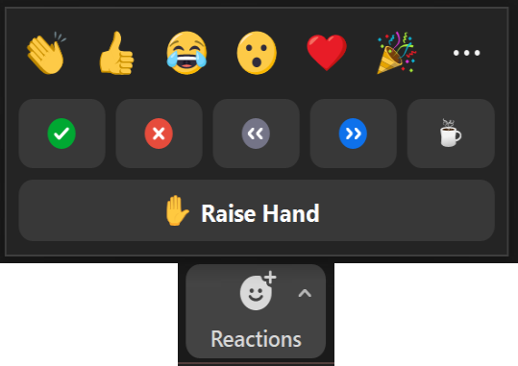
XRDevLab
Workshop Support
Backchannel and interaction:
Handouts are available in the Zoom chat and on the XR Lab website.

Slide 4
XRDevLab
XR Lab
Notes:
Our team: Ali, Associates, Affiliates and clients; see our web page – QR code on the handout and end of each presentation.

Slide 5
Workshop Objectives
XRDevLab
Demonstrate the use of Magicschool.ai to create lessons that align with the task engagement framework.
Show techniques to develop tasks that challenge students' critical thinking and make them resistant to AI-generation.
Encourage collaboration and sharing ideas and asking questions.

Slide 6
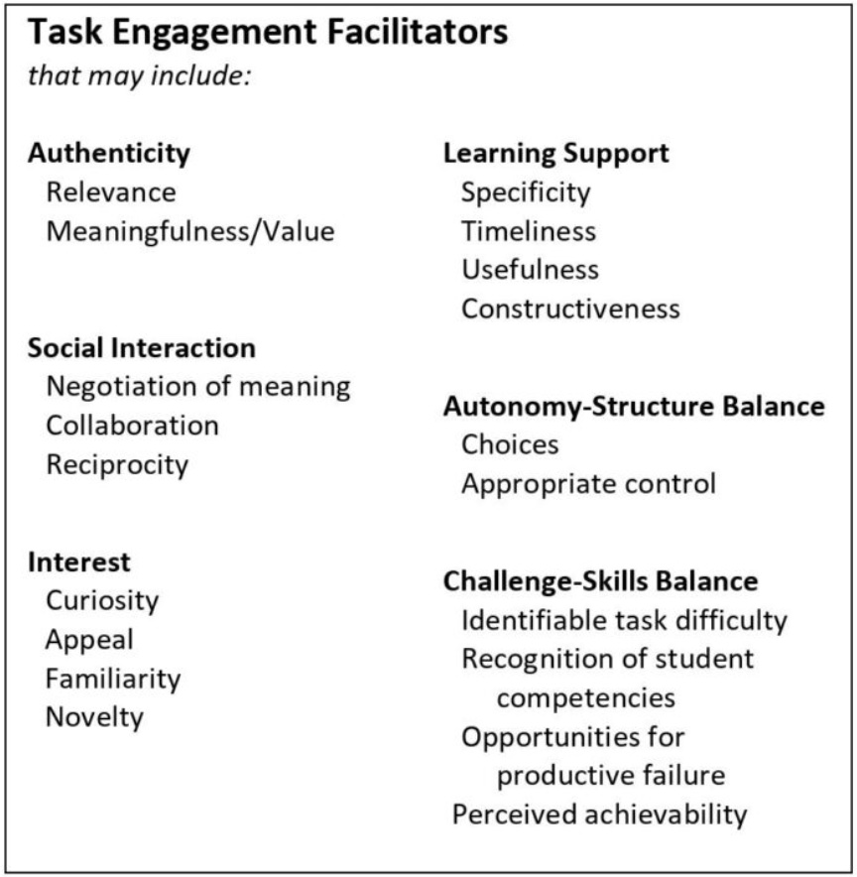
Task Engagement
Reason to use technology
Links to learning theories including UDL, differentiation, and motivation
Facilitators are cross-disciplinary and for all learners, supporting equity and diversity in instruction
Focuses on learners rather than technologies
Available on labs.wsu.edu/xrdevlab
Notes:
Links to UDL, differentiation, UT’s “8 principles of effective teaching,” etc
Transition questions:
How many of you are familiar with chatbots?

Slide 7
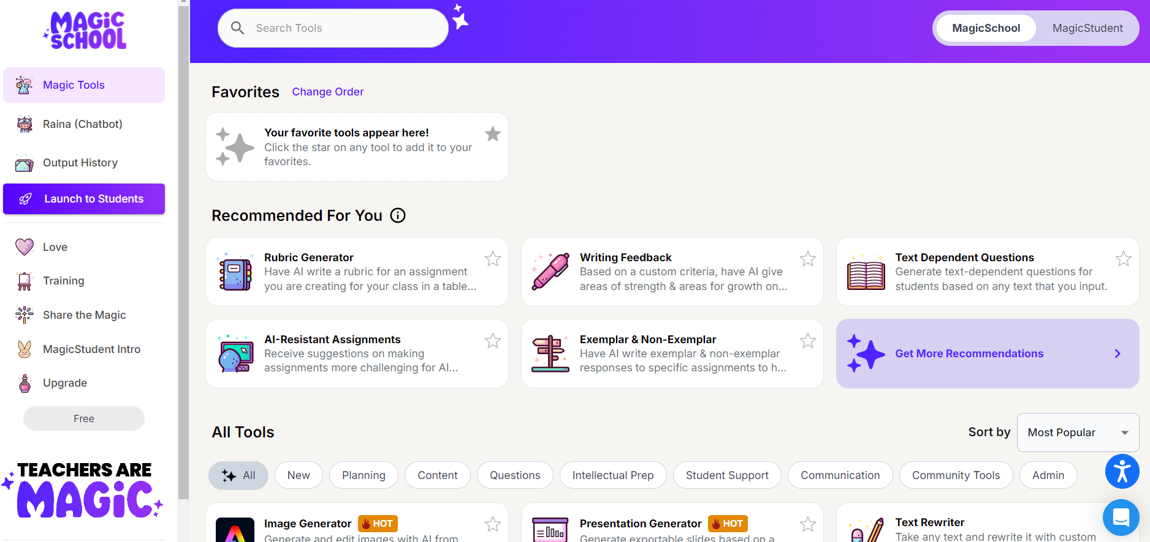
Magicschool.ai
XRDevLab
Notes:
Chatbot use case:
Writing tutor, author interview, talk to famous figure, etc.

Slide 8
Your Turn (Create Yours)
XRDevLab
Grade Level
Topic, Standard, or Objective
Additional Criteria
Standards
Notes:
About 15 minutes and we'll come back together to talk about your experiences.

Slide 9
Discussion
XRDevLab
How would this lesson work for all the students in your class?
How could you make the lesson more engaging?
Notes:
Continue with lab time: build another one

Slide 10
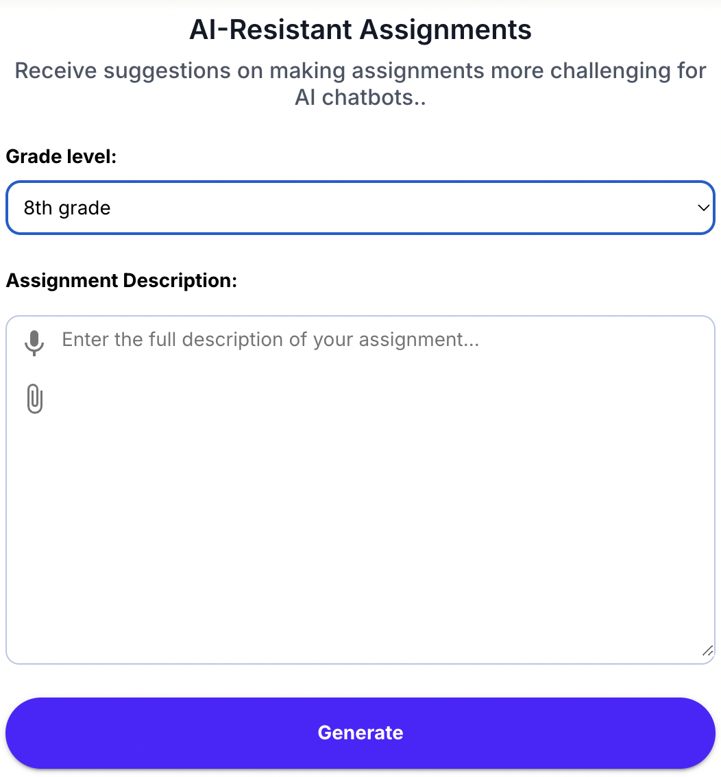
AI-Resistant Assignments
XRDevLab
Notes:
Continue with lab time: build another one

Slide 11
XRDevLab
Example
Notes:
Continue with lab time: build another one

Slide 12
XRDevLab
Example
Feel free to copy, paste, and edit the results!
Notes:
Continue with lab time: build another one

Slide 13
Create Your AI-Resistant Tasks!
XRDevLab
Grade level
Assignment description
Notes:
Continue with lab time: build another one

Slide 14
Discussion
XRDevLab
What are the challenges you encountered while designing the tasks?
How does this tool support diversity and equity in your class?
Notes:
Continue with lab time: build another one

Slide 15
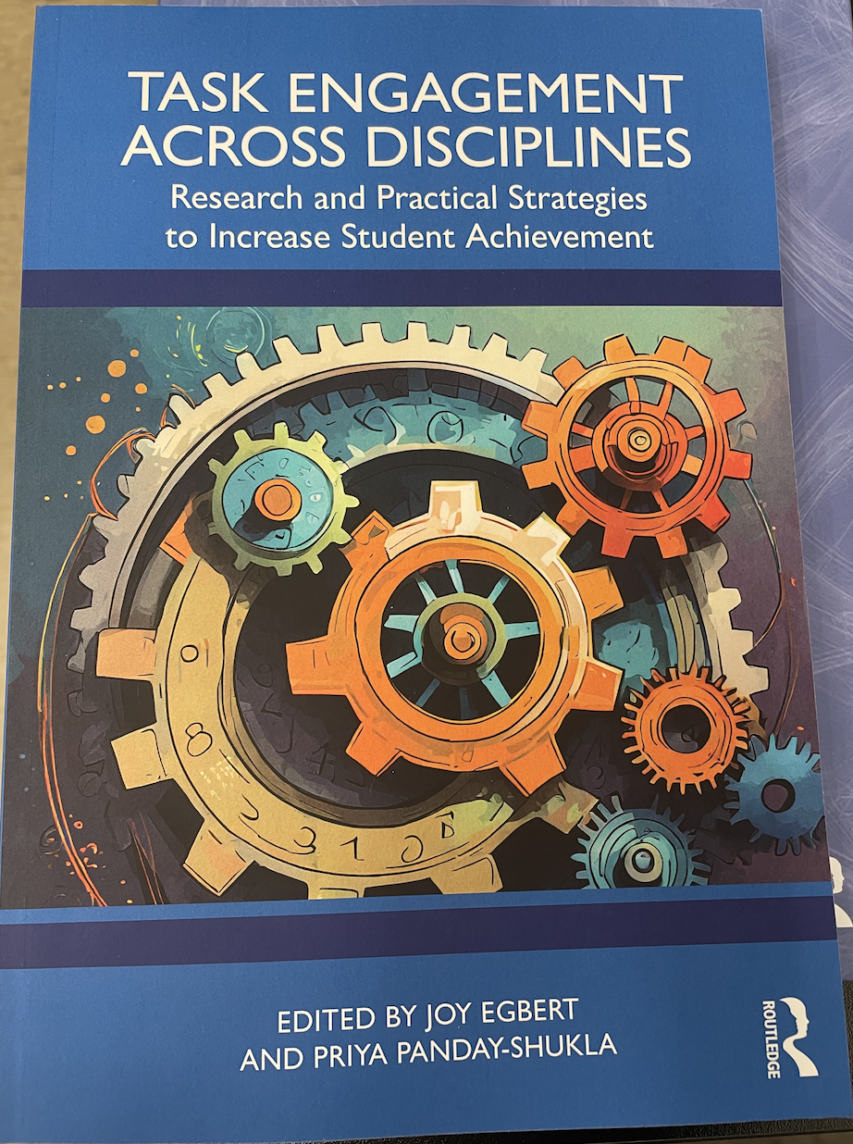
Task Engagement Resource
XRDevLab
Notes:
Continue with lab time: build another one

Slide 16
Thank you
XRDevLab
312 Cleveland Hall
coe.xrlab@wsu.edu
labs.wsu.edu/xrdevlab
XR Dev Lab
/xrdevlab
@WSUXRDevLab
Notes:
Will be around up 3.45

