Slide 1
XRDevLab
AI Use for Giving Feedback and Teacher Reflection
Joy Egbert and Mazen Alyobi
WSU College of Education XR Development Lab with the support of
The WSU Transformational Change IDEA Initiative

Slide 2
XRDevLab
Workshop Information and Etiquette
Please keep your microphones muted unless you have the floor.
Slides are posted on the XR Lab website: https://labs.wsu.edu/xrdevlab/

Slide 3
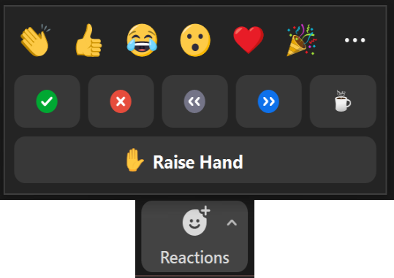
XRDevLab
Workshop Support
Backchannel and interaction:
Post comments and questions to the Zoom chat and look for attachments here.

Slide 4
XRDevLab
XR Lab
XR Development Lab, 312 Cleveland Hall, College of Education
Notes:
Our team: Ali, Associates, Affiliates and clients; see our web page – QR code on the handout and end of each presentation.

Slide 5
Workshop Objectives
XRDevLab
Raise awareness of the role of AI use in diversity, equity, and inclusion.
Demonstrate the use of AI to give writing feedback.
Demonstrate how AI can support teacher reflection.
Answer questions.

Slide 6
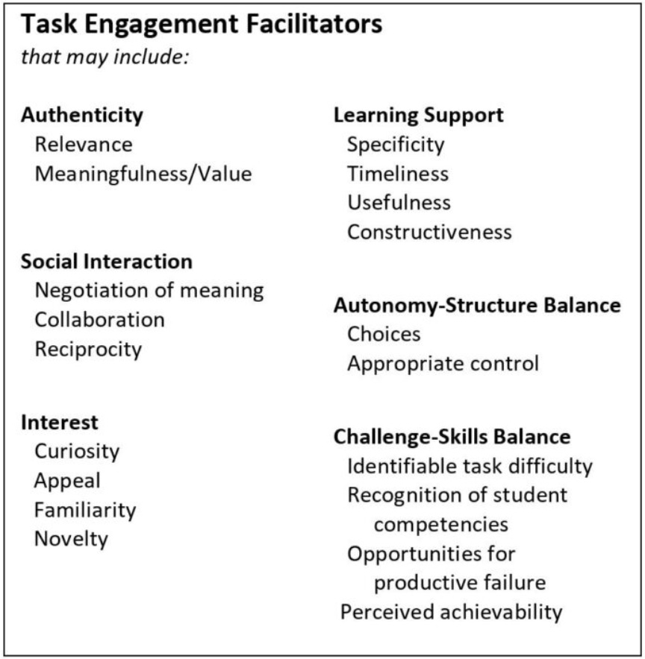
Task Engagement
Reason to use technology
Links to learning theories
Facilitators are cross-disciplinary and for all learners, supporting equity and diversity in instruction
Focuses on learners rather than on technologies
TODAY: Feedback and learning support
Available on labs.wsu.edu/xrdevlab
Notes:
Links to UDL, differentiation, UT’s “8 principles of effective teaching,” etc
Transition questions:

Slide 7
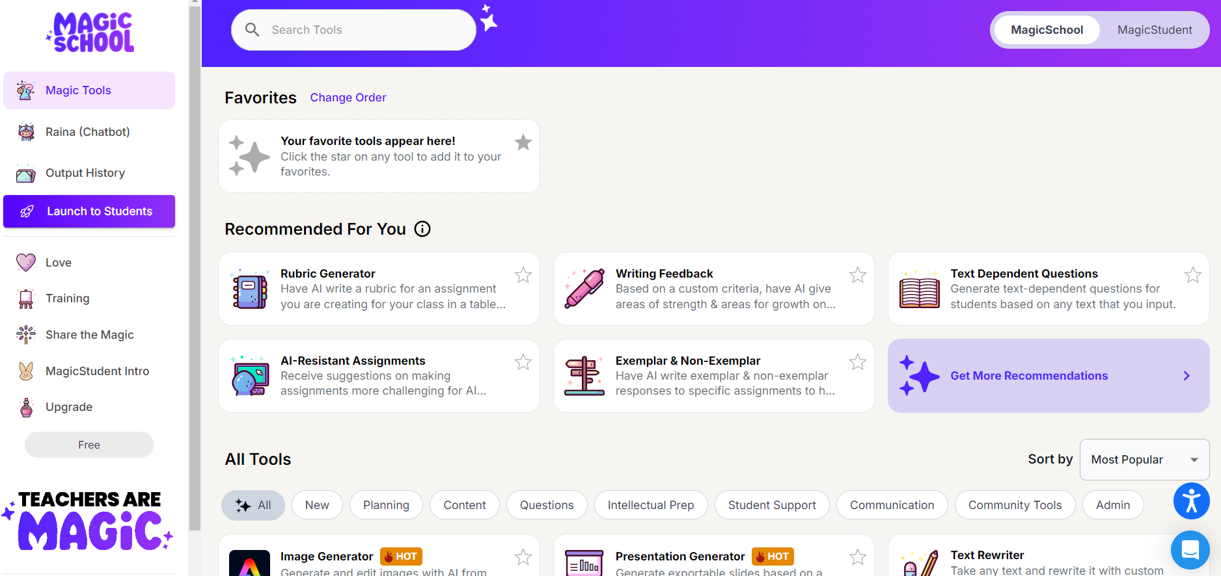
Magicschool.ai
XRDevLab
Notes:
Chatbot use case:
Writing tutor, author interview, talk to famous figure, etc.

Slide 8
Discussion
XRDevLab
How would this work for all the students in your class?
How could you make the feedback/learning support more engaging?
Notes:
Continue with lab time: build another one

Slide 9
Sample Essays
XRDevLab
Choose one from the chat or use one from your device.
Notes:
Continue with lab time: build another one

Slide 10
Discussion/Questions
XRDevLab
How would this work your class?
How could you make your feedback/ learning support more engaging?
Notes:
Continue with lab time: build another one

Slide 11
Notes:
Task Engagement
Social interaction is important..
According to social interaction in task engagement ..Joy

Slide 12
AI Use for Teacher Reflection
XRDevLab
?
How much does the average student speak in one hour of class
27 seconds
Teachers talk 70-80% of class time.

Slide 13
Reflecting on Our Instruction
XRDevLab
When was the last time you modified your instruction based on classroom observations or data?
Notes:
How many of you think Blu evaluation not authentic? Blue eval, and Reflections
(Q&A In-Person V.S Zoom ICON)

Slide 14
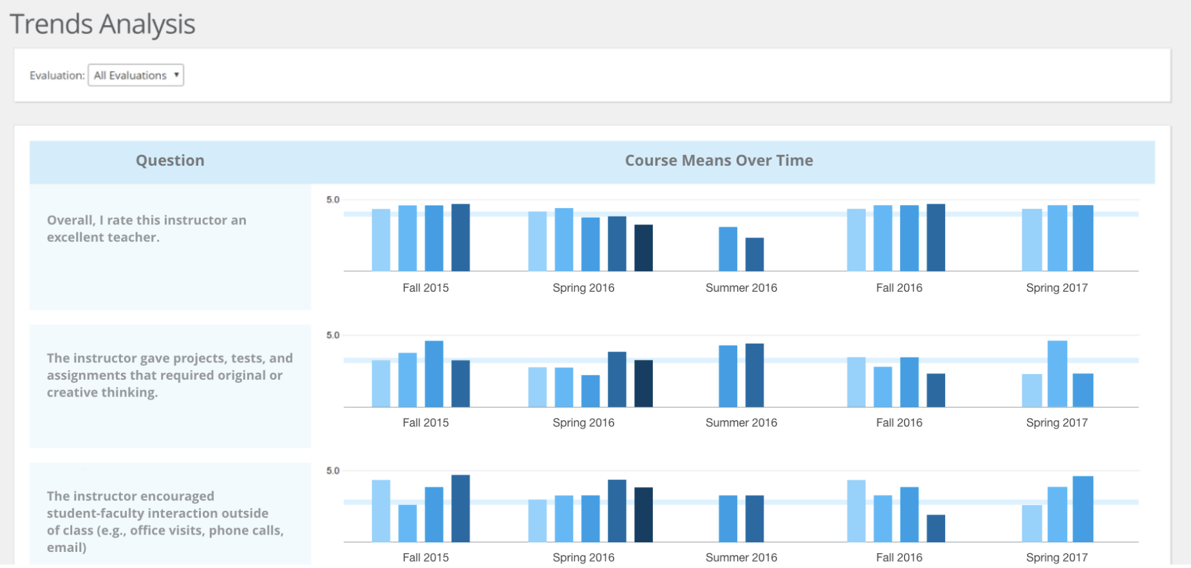
Blue Evaluation
XRDevLab

Slide 15
AI Use for Teacher Reflection
XRDevLab
“
We do not learn from experience. We learn from reflection on experience.
– John Dewey

Slide 16
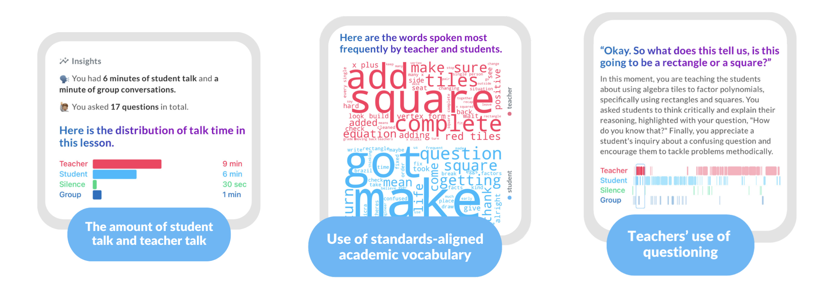
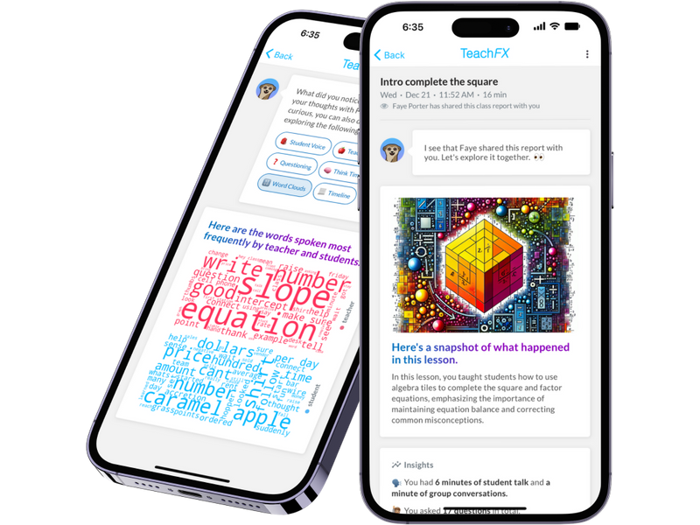
TeachFX
XRDevLab
TeachFX provides AI-powered instructional feedback that helps teachers facilitate meaningful student discourse.
Notes:
Free 3 recordings

Slide 17
Academic Language Model
XRDevLab

Slide 18
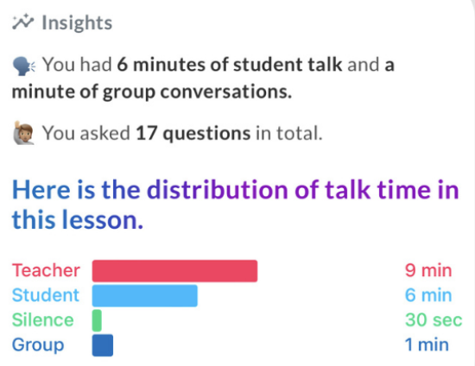
Time Distribution
XRDevLab

Slide 19
Think Time
XRDevLab

Slide 20
Building on Students’ Ideas
XRDevLab

Slide 21
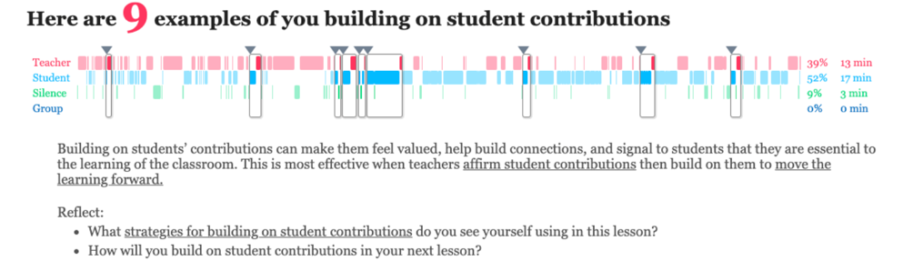
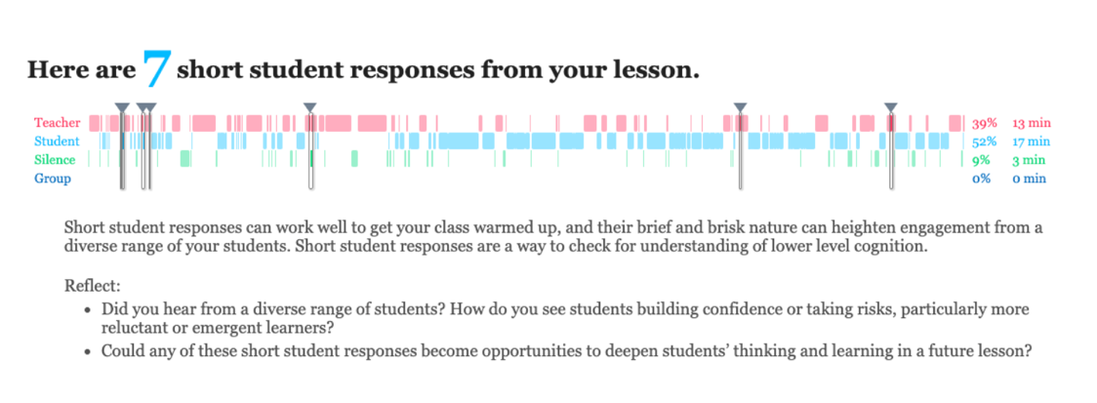
XRDevLab
Notes:
Open-Questions V.s Closed questions
Isntead of “What”, we ask ”Why” or “How” “Telll me more” “What do you mean”.

Slide 22
Report Walk-through
XRDevLab

Slide 23
Demonstration

Slide 24
Affordances
XRDevLab
Non-judgmental
Visual
Provides reflection prompts
Accessible
Sharable
Detailed
Personal
Private

Slide 25
XRDevLab

Slide 26
Discussion
XRDevLab
What are the challenges you might encounter while using these tools?
How can these tools support diversity and equity in your class?
Notes:
Identifying Engagement Gaps:
By analyzing participation data, TeachFX can help teachers identify which students are engaging less in discussions. This insight allows educators to implement strategies to ensure that all voices are heard, particularly from marginalized groups.
Tailoring Instruction:
Feedback from TeachFX can highlight areas where teaching methods may not be resonating with all students. Teachers can adapt their approaches based on diverse learning styles and cultural backgrounds, fostering an inclusive environment.
Promoting Inclusive Practices:
The tool can encourage the use of varied questioning techniques that engage all students. For instance, teachers can focus on open-ended questions that invite multiple perspectives, thereby promoting a richer classroom dialogue.
Supporting Culturally Responsive Teaching:
By reflecting on the feedback, teachers can ensure that their materials and examples reflect the diversity of their students. This can make lessons more relevant and relatable, enhancing student engagement and participation.

Slide 27
XRDevLab
?
Q&A

Slide 28
Thank you
XRDevLab
312 Cleveland Hall
coe.xrlab@wsu.edu
labs.wsu.edu/xrdevlab
XR Dev Lab
/xrdevlab
@WSUXRDevLab
Notes:
Will be around up 3.45

