Slide 1



AI Use for Teachers and Students
WSU College of Education XR Development Lab
with the support of
a College of Education Faculty Funding Grant

Slide 2
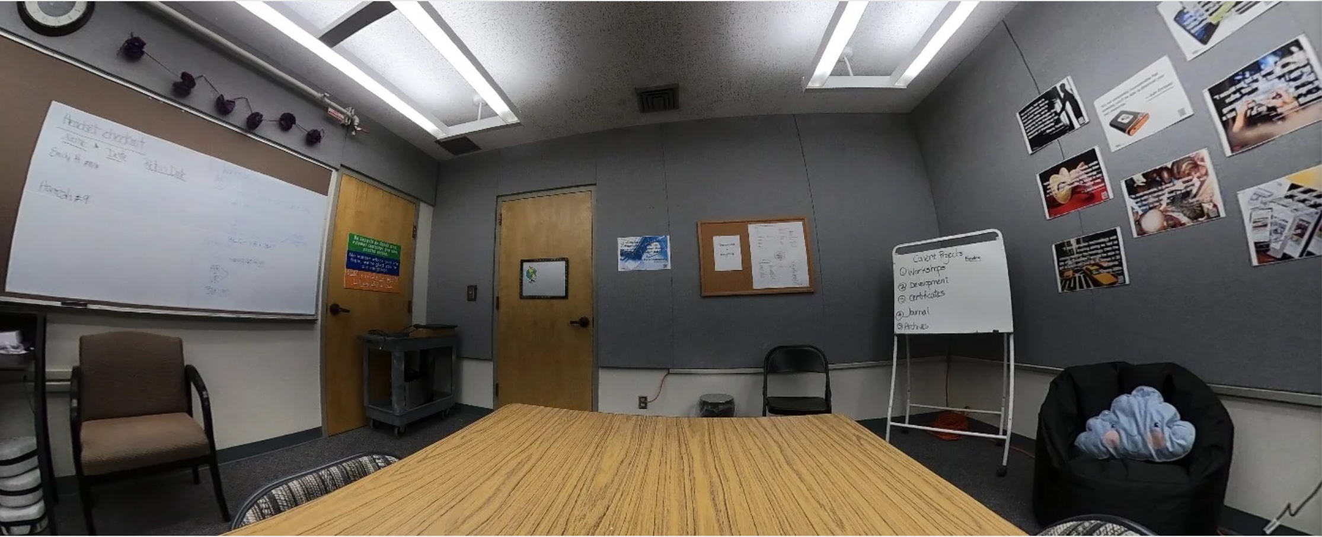
XRDevLab
XR Lab
XR Development Lab, 312 Cleveland Hall, College of Education
Notes:
Our team: Ali, Associates, Affiliates and clients; see our web page – QR code on the handout and end of each presentation.

Slide 3

Workshop Objectives
XRDevLab
Raise awareness of the role of AI use in education
Demonstrate the use of AI for teachers and their students
Provide examples and resources
Answer questions

Slide 4
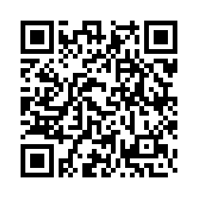
Pre-Survey
XRDevLab

Slide 5
Workshop #1: AI for Instructional Purpose
XRDevLab

Slide 6
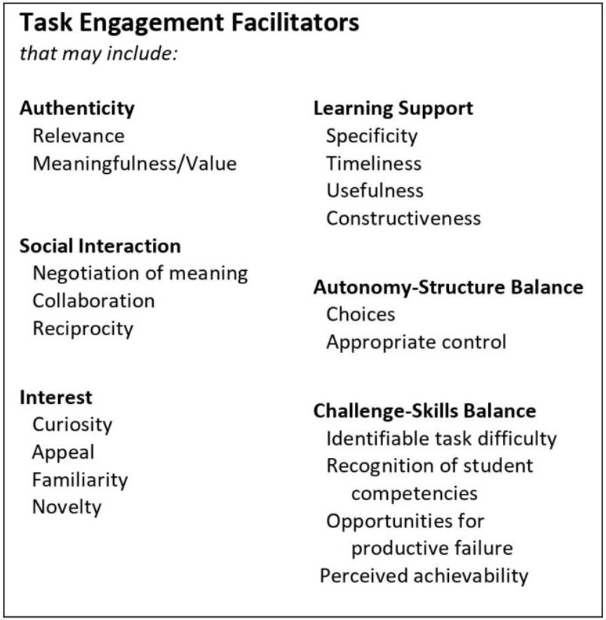
Task Engagement
XRDevLab
Reason to use technology
Facilitators are cross-disciplinary and for all learners, supporting equity and diversity in instruction
Focuses on learners rather than on technologies
Available on labs.wsu.edu/xrdevlab

Slide 7
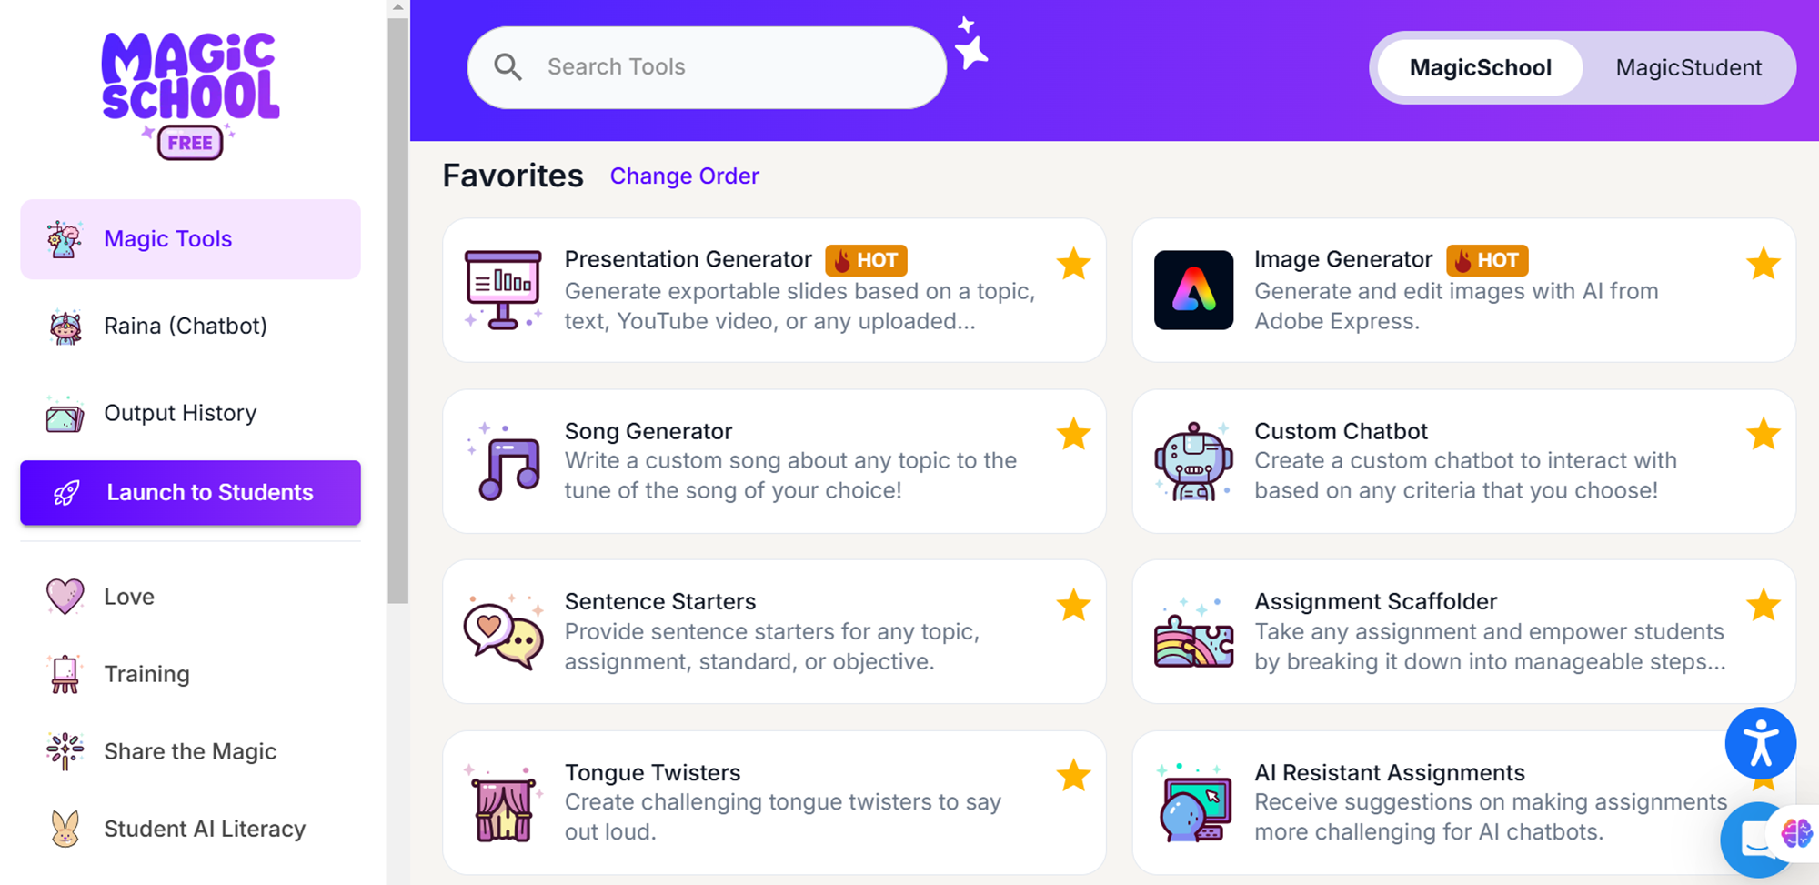
Assignment Scaffolder
XRDevLab

Slide 8

Example Prompt
XRDevLab
Objective: Write a five-paragraph personal narrative about a memorable experience in your life.
Steps to Complete the Assignment:
Brainstorm Your Story
Think about an exciting, happy, or challenging moment in your life.
2. Organize Your Ideas
Paragraph 1: Introduction
Paragraph 2: Body - Beginning
Paragraph 3: Body - Middle
Paragraph 4: Body - End
Paragraph 5: Conclusion
3. Write Your Story​
Use descriptive words to help readers picture what happened.​
Use transition words like first, next, then, and finally.​
​
4. Revise & Edit​
Check for spelling, punctuation, and sentence flow.​
Read your story out loud to make sure it makes sense.

Slide 9
Assignment Scaffolder
XRDevLab
How does this tool help you as a teacher?
(Try to recall the task engagement facilitators)
?
Notes:
Learning Support: The scaffolding process breaks down assignments into clear steps, providing guidance for students who may struggle with open-ended tasks. It simplifies instructions, making them accessible for diverse learners, including MLLs and students with different learning needs.
Autonomy-structure balance: By scaffolding the assignment in a way that promotes gradual independence, students gain a sense of control over their learning process.
Interest: If teachers design the assignment with student interests in mind, the tool helps communicate the task effectively.

Slide 10


Text Scaffolder
XRDevLab
Objective:
To practice how to use AI to create structured, engaging, and accessible text for students to support differentiated instruction
To help struggling readers engage with complex texts
To save teachers time in lesson preparation

Slide 11
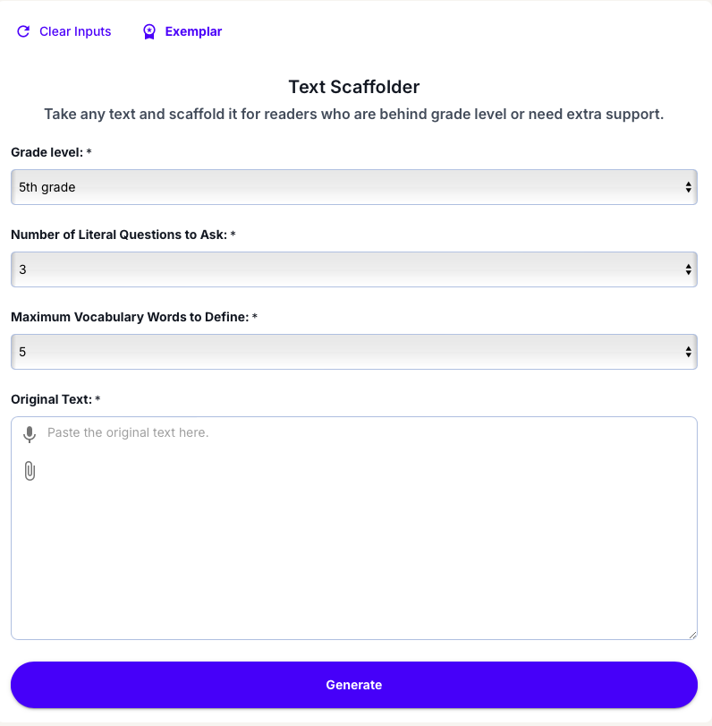
How the Text Scaffolder Works
XRDevLab
Select a Text: Choose a passage from your lesson material.
Input the Text: Copy and paste it into the MagicSchool AI Text Scaffolder.
Customize: Adjust difficulty levels, key vocabulary highlights, and comprehension questions.
Generate Output: Receive a structured version with scaffolded elements to support students.
Edit & Use: Modify as needed and integrate it into your lesson plan.

Slide 12
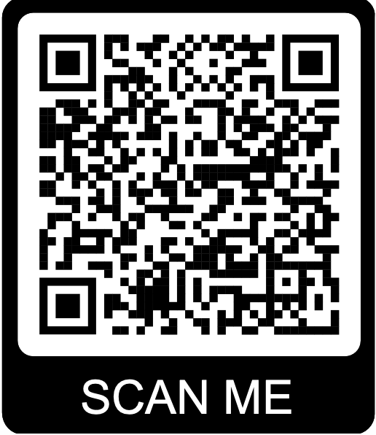
Hands-on Activity - Let’s Practice!
XRDevLab
Open MagicSchool AI’s Text Scaffolder https://app.magicschool.ai/tools/scaffolder , or scan the QR code on your device.
Work in pairs or individually to input a short text.
Adjust the scaffolding options based on your students’ needs.
Generate a scaffolded text and discuss how you can use it in your classroom.

Slide 13

Let's talk about it!
XRDevLab
As a teacher, how can you use this AI to engage your students?
?

Slide 14
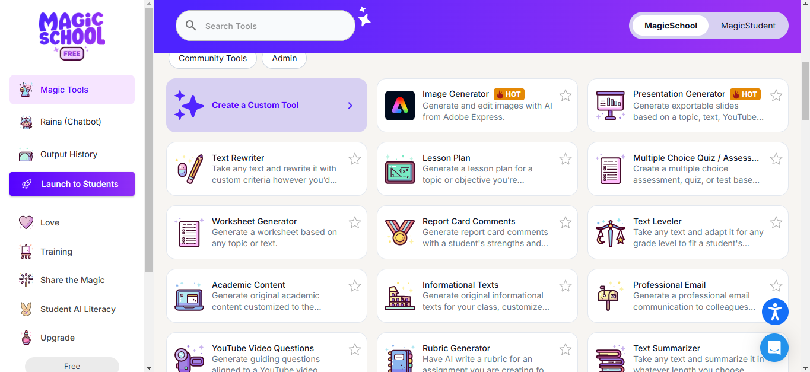
Presentation Generator
XRDevLab
Notes:
Continue with lab time: build another one

Slide 15
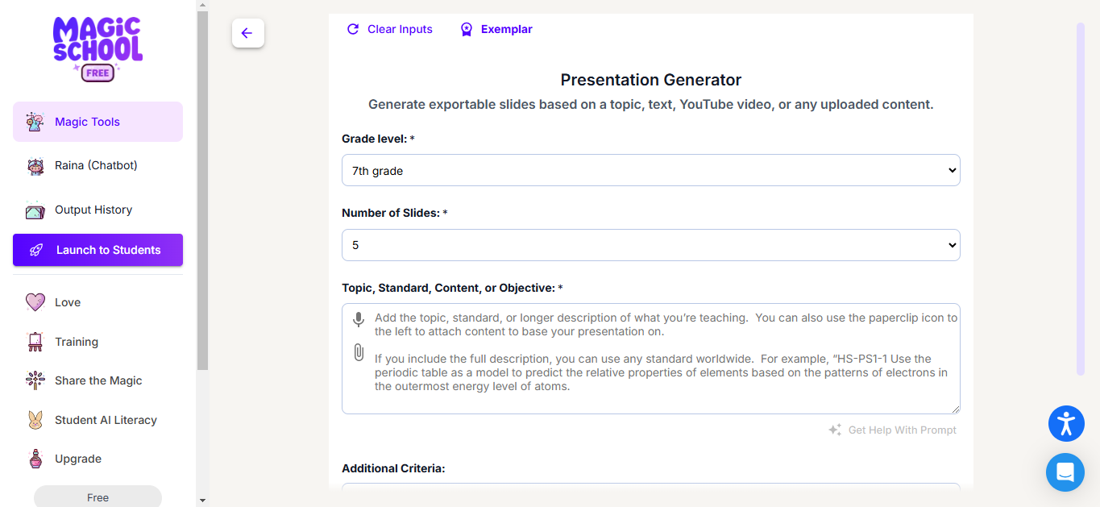
Presentation Generator
XRDevLab
Notes:
Continue with lab time: build another one

Slide 16
Discussion
XRDevLab
What are your thoughts on using a presentation generator in your teaching practice? Do you think they can be effective?
Can you share scenarios or activities that might engage students?
?
Notes:
Continue with lab time: build another one

Slide 17
Break

Slide 18
XRDevLab
Workshop #2: Supporting Students to Use AI

Slide 19
XRDevLab
Magic Student
Magic School
Magic Student
Tools for students that teachers can customize before launching them to students.
Tools for teachers to help them prepare lesson plans, differentiate, write assessments, write IEPs, communicate clearly, etc.
Vs.

Slide 20

XRDevLab
Overview

Slide 21
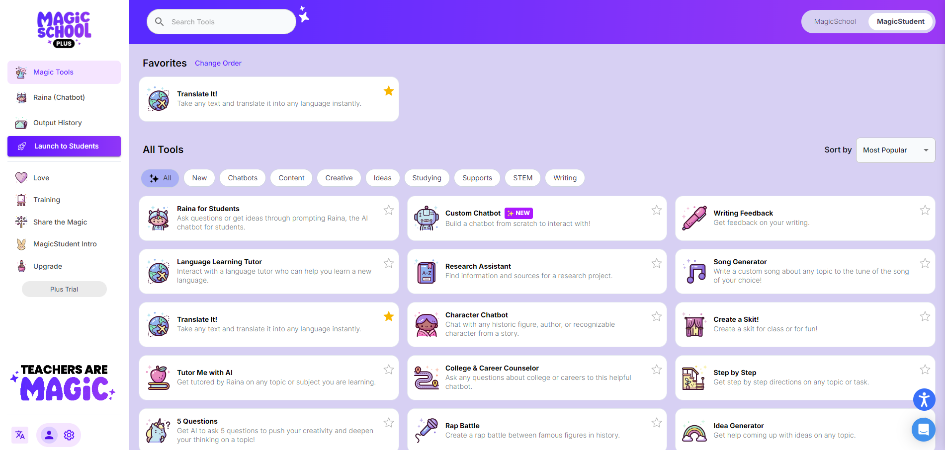
XRDevLab
How to assign a tool
1 Change to Magic student
3
2 Select and customize a tool

Slide 22
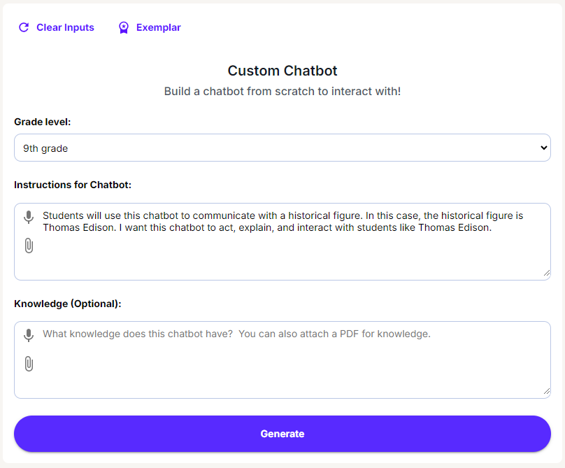
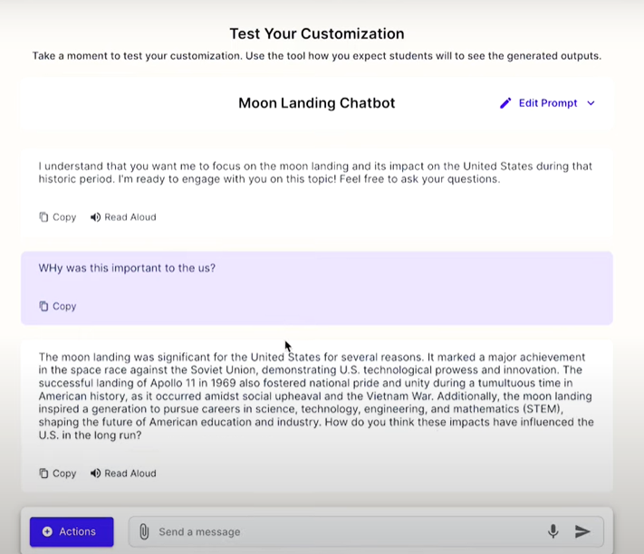
XRDevLab
Example
1 Change to Magic student
2 Select and customize a tool
3 Launch to Students

Slide 23
Step-By-Step Tool
XRDevLab
XRDevLab
Who has used an AI tool to generate learning steps for students?
What do you currently use to help students break down tasks?
Brief Overview:
Magic School’s Step-by-Step Tool helps students learn anything by generating a customized step-by-step guide.
Just enter the grade level and help needed, and the tool creates an easy-to-follow breakdown.
Students can edit the prompt if they need adjustments.

Slide 24
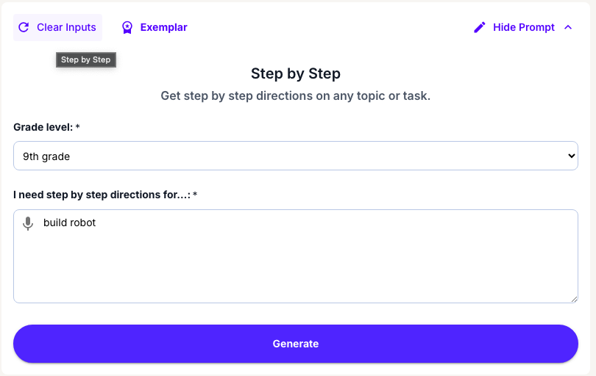
How to Use the Step-by-Step Tool
XRDevLab
1. Enter Prompt: Add the grade level and what help is needed (e.g., “Grade 5 – How to write a summary”). 2. Generate Steps: The tool provides a detailed breakdown of the process. 3. Edit & Adjust: Modify the prompt if the steps don’t fit your needs. 4. Use & Apply: Follow the guide for learning or teaching.
💡 Example: “Grade 8 – How to analyze a short story” → The tool generates a structured plan.
Now It’s Your Turn!

Slide 25
Now It’s Your Turn!
XRDevLab
Please create your own step-by-step guide using the tool.
Edit the output to fit student needs.
Test it out: how would this help your students?
?

Slide 26
Engaging Ways to Use It
XRDevLab
Think about different ways to apply this tool:
Lesson scaffolding
Homework support
Independent student learning
Questions:
How could your students use this tool to create their own learning guides?
What are creative ways to integrate this into your classroom?
?

Slide 27
Engaging Learning with Quiz Me
XRDevLab
How do you currently check for student understanding in class?
?

Slide 28
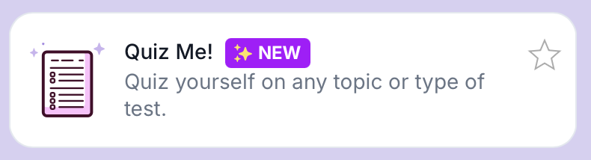
What Is Quiz Me?
XRDevLab
AI-powered quiz generator
Adapts to different subjects and learning levels
Provides instant feedback
Customizable for teachers' needs

Slide 29
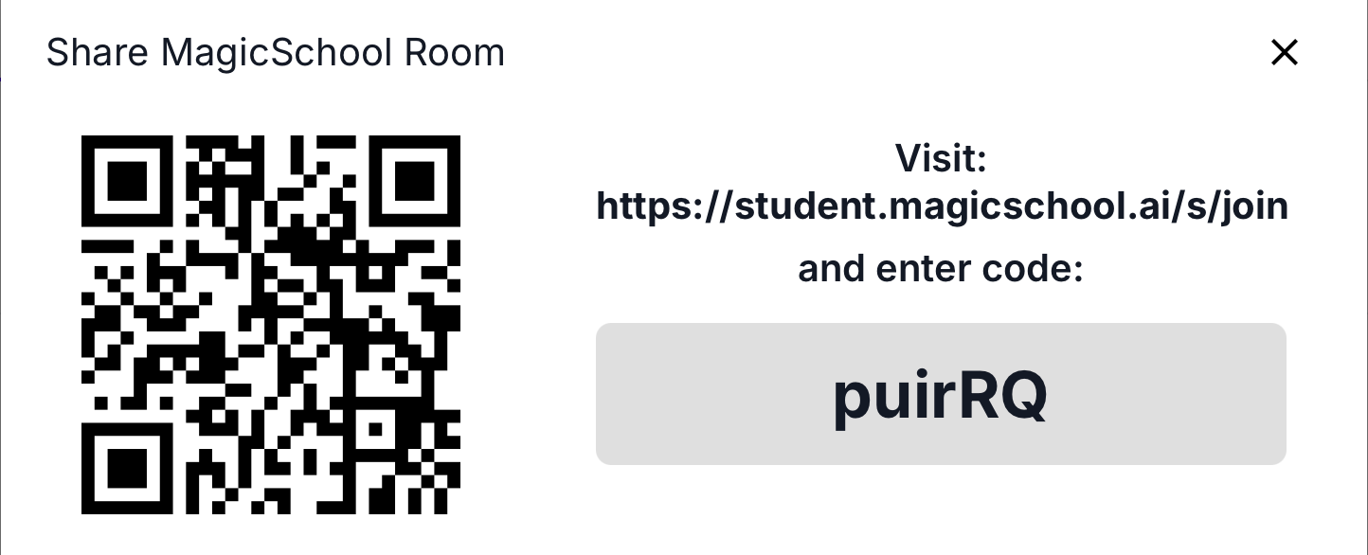
Let’s Try It Out
XRDevLab

Slide 30
Discussion
XRDevLab
How did you find the quiz?
What would you modify to suit your classroom needs?

Slide 31
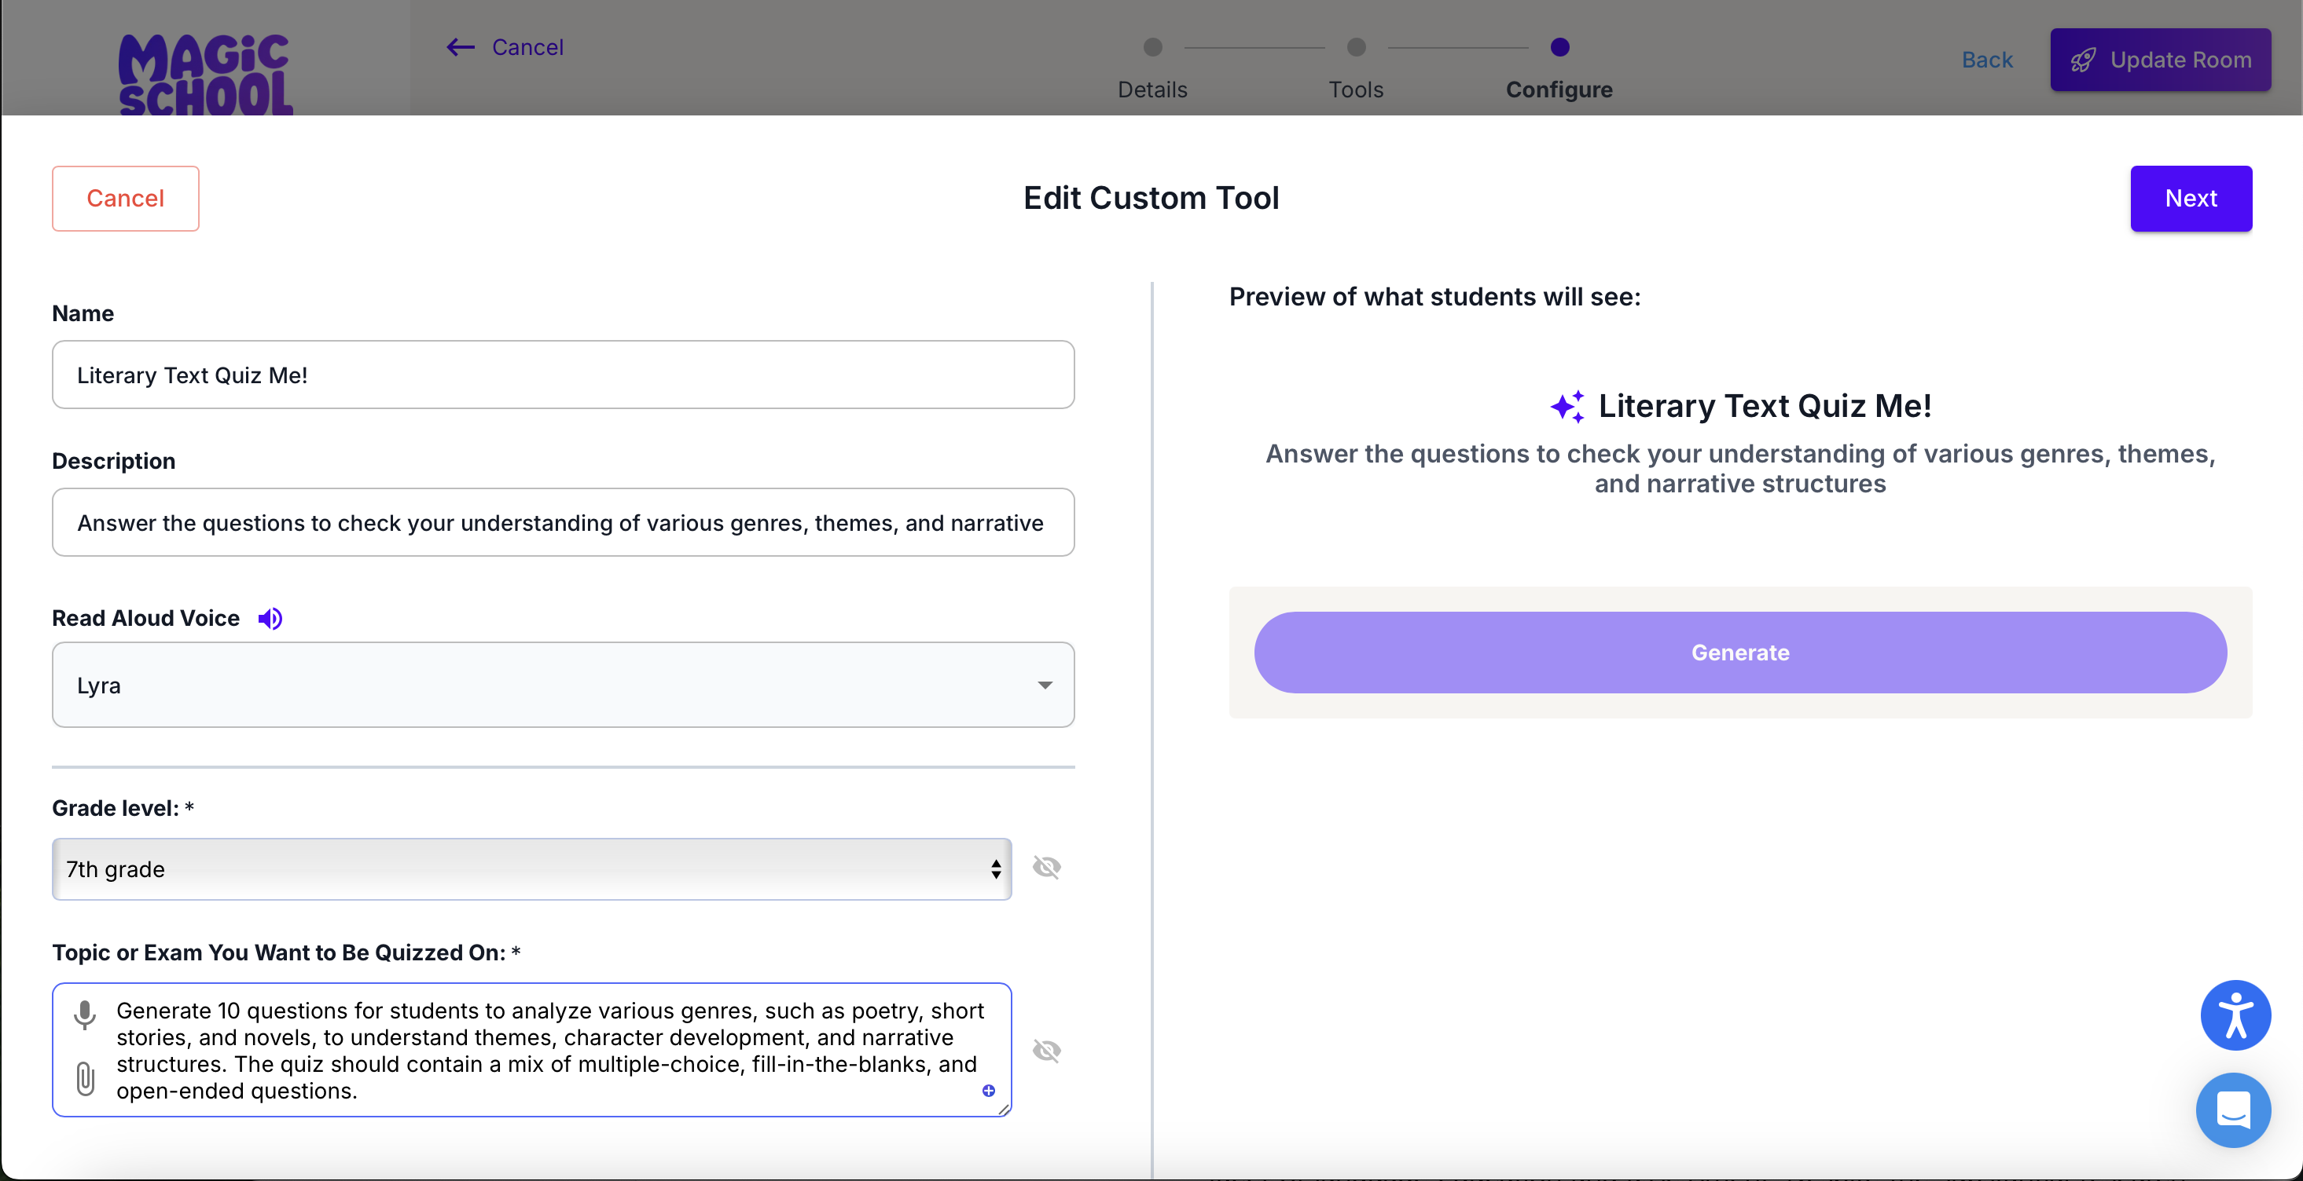
XRDevLab
Live Demo

Slide 32
Classroom Application
XRDevLab
How can teachers use Quiz Me in the class?
How does this tool support Task Engagement?
?

Slide 33
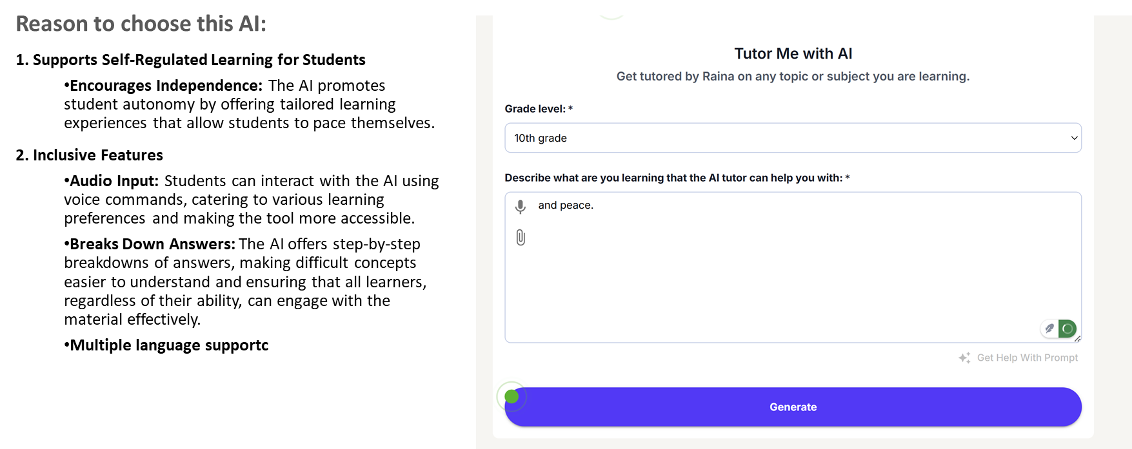
Tutor Me With AI
XRDevLab

Slide 34
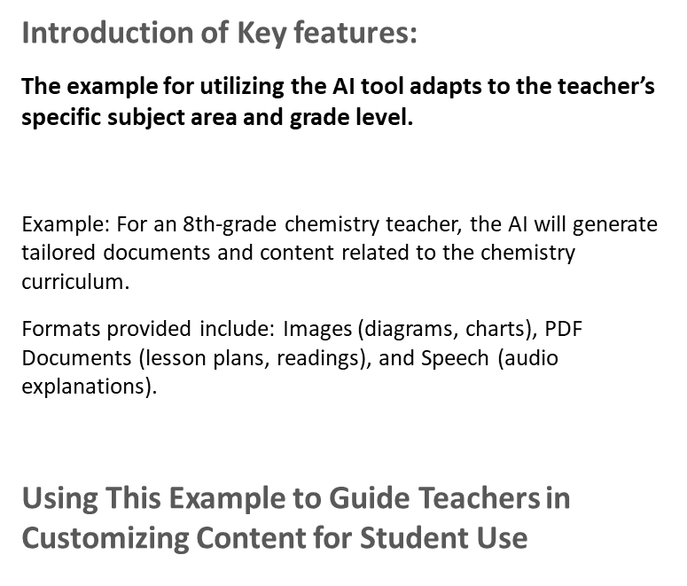
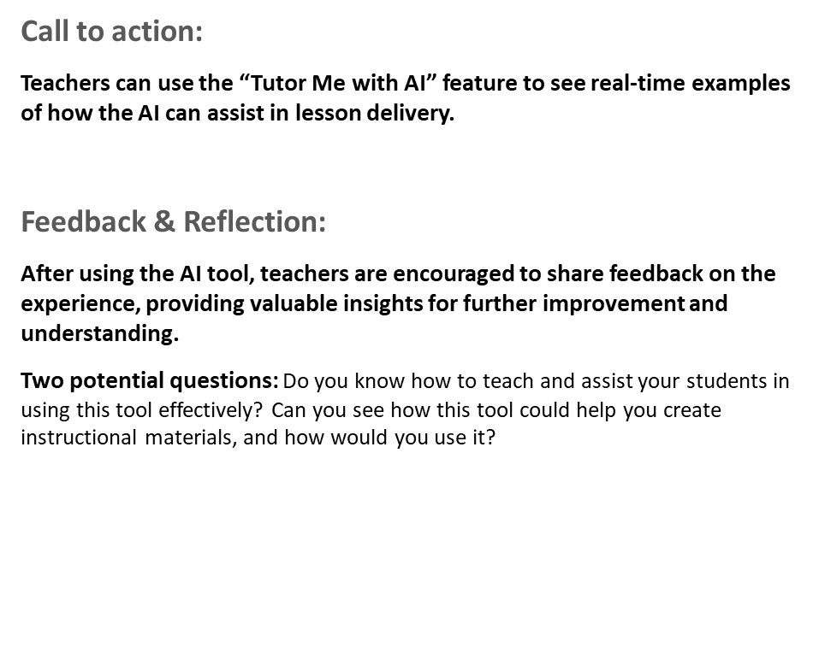
Tutor Me With AI
XRDevLab

Slide 35

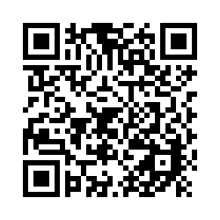




Thank you
XRDevLab
Post-Survey
312 Cleveland Hall
coe.xrlab@wsu.edu
labs.wsu.edu/xrdevlab
XR Dev Lab
/xrdevlab
@WSUXRDevLab
Notes:
Will be around up 3.45

